Slide 1
Science Project
By Avanish Murkute
6th B
Roll No.12

Slide 2
Study India’S contribution to satellite technology through project GSAT (communication satellite). Showcase how these satellites help in weather prediction,navigation and disaster management across India

Slide 3
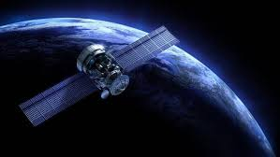
What is GSAT satellites?
The GSAT(GeosynchronosSatellite)are India”S indigenously developed communications satellites,used for digital audio,data and video brocasting.

Slide 4
What is the use of GSAT Satellites? GSAT Satellites are communications satellites developed in India that are used for digital audio data and video broadcasting.ISRO developed the GSAT series of geosynchronous satellites with the goal of making India self-sufficient in broadcasting services.

Slide 5
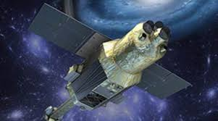
How do these satellites help in weather forecasting?
These Weather Satellites are an important observational tool for all scales of NWS forecasting operations. Satellite data, having a global view, complements land-based systems such as radiosondes, weather radars, and surface observing systems. There are two types of weather satellites: polar orbiting and geostationary.

Slide 6
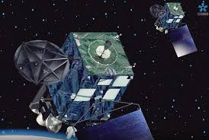
How do satellites help with disaster management?
How satellites play a role in disaster relief - Viasat
ANS --Satellites enable communication during disasters when terrestrial infrastructure is down or over capacity. Satellite internet is critical to facilitating first response efforts by keeping airports, shelter locations, healthcare facilities, and utility operations up and running.31 Aug 2023

Slide 7
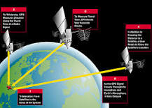
How do satellites help in navigation?
Satellite Navigation - GPS - How It Works | Federal Aviation ...
To accomplish this, each of the 31 satellites emits signals that enable receivers through a combination of signals from at least four satellites, to determine their location and time. GPS satellites carry atomic clocks that provide extremely accurate time.

Slide 8
Thank you

